Slide 1
Design a LOGO that represents the identity of your core class.
The logo must be eye catching, meaningful and transferable.
The design must clearly show your class name e.g. 9M
Be creative!!!
The winning logo will be used for the year to represent your class around the school.
There is limits to how you can produce your logo but it must be able to be uploaded to your teams page.
Scan in a drawing, use your camera, photoshop, illustrator, logo creator- the options are endless.
Designs must be uploaded to your teams page by Friday the 5th of March to qualify for the prizes.
Good luck
(enter as many times as you like)

Slide 2
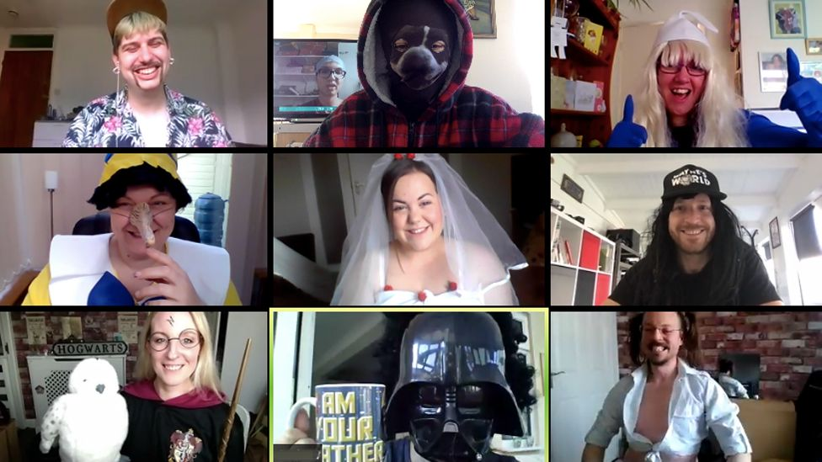
Inter-class ZOOM meeting competition
Join with your classmates and create a winning zoom meeting.
This could be a lesson with a twist, some comic relief, or a creative way to make online lessons fun and engaging.
Please select the best 3- 4 mins to share.
Entry's close on Friday the 5th of March!!
Please upload to your entry to your classroom teacher so they can share your entry with the judges. Class prizes available for 1st and 2nd.

Slide 3
LASALLIAN WORKOUT OF THE DAY (WOD)
MONDAY
‘CINDY’
TUESDAY
’FULL-BODY SPRINT’
WEDNESDAY
Repeat exercises below as many times as you can in 20mins :
5 Sit-ups
10 Push-ups
15 Air Squats
A classic CrossFit WOD. Familiar and perfect for an at-home workout.
How many circuits can you do in 20mins?
Repeat the following circuit 7 times:
10 Push-ups
10 Air Squats
Run 200m
How long does it take you to do the following 7 times?
Short bursts of movements with high rounds. This WOD will get you sweating quick
‘BODYWEIGHT WOD’
Repeat the following circuit 8 times:
10 Push-ups
10 Air Squats
10 Burpees
10 Air Squats
How long does it take you to do the following 8 times?
A well-rounded WOD.

Slide 4
LASALLIAN WORKOUT OF THE DAY (WOD)
THURSDAY
FRIDAY
RESULTS
Send your results to your PE teachers via your teams pages. Video proof will be required for the winner to collect their prize.
‘FULL-BODY DECREASING LADDER’
10-9-8-7-6-5-4-3-2-1 Rep Rounds:
Burpees
Push-ups
Sit-ups
How long does it take you to complete the 10 rounds?
Quick full-body work.
‘DISTANCE BURPEES’
For Time:
800m of Broad Jump Burpees
How long does it take you to complete 800m?
Ideal if you have a wide and long space to move. No one wants to do an 800m workout in a hotel room, or on busy sidewalk
Remember that excercising with another member of your family increases both your physical and social well being (Hauora).

Slide 5
DLS lockdown reading challenge
Complete as many reading challenges as you can and share them on your teams pages – spot prizes for participation!
Listen to an audiobook | Read a comic/graphic novel | Make a trailer for a book – an animation, GIF, PowerPoint with voice over, or film yourself talking about your book. Please share! | Read something funny | Make a miniature book Using one piece of paper! Or – try book folding
Read a book set in a different time or place | Read out aloud to a member of your family – in your house, via FaceTime, or to a pet! | Read something that a family member enjoyed reading as a child | Watch a play | Have a go at creating a book spine poem

